Slide 1
Team Lead 4 Presentation
Team Café - Kyle
The Middle Men- Don
Bloonagins - Chase
ScoSoft - Austin

Slide 2
Overview
Cohesion Vs. Coupling
GRASP (First 5 Principles)
Coding Standards
Developer Manual
Using the Gantt
Gantt and Code Issues (The Roast)

Slide 3
Cohesion Vs. Coupling
Know these concepts for the oral exam and for the post mortem!
GRASP: General Responsibility Assignment Software Patterns

Slide 4
Jargon alert: terms and definitions
coupling: the degree to which each program module relies on other modules
cohesion: a measure of how well the operations in a module work together to provide a specific piece of functionality
encapsulation: synonym for “information hiding” and restricting access.
reusability: likelihood a segment of structured code can be used again to add new functionality with slight or no modification

Slide 5
Outline
Modules
Cohesion
Coupling
Encapsulation & ADTs
Visability

Slide 6
The Nine GRASP Patterns
Creator
Information Expert
Low Coupling
Controller
High Cohesion
Polymorphism
Pure Fabrication
Indirection
Protected Variations

Slide 7
Modules
– “Lexically contiguous”
• Connected in the code (not just related by control flow or data).
– “Boundary elements”
• { ... }
• begin ... end
– “Aggregate identifier”
• A name for the entire module
What is a module?
lexically contiguous sequence of program statements, bounded by boundary elements, with aggregate identifier
Examples
procedures & functions in classical PLs
objects & methods within objects in OO PLs

Slide 8
Modularity is for your benefit not the computers
Computers do not need code to be modularized.
In fact in order to run, a program must be translated into an imperative, low-level language: binary.
People do need modularity in order to conceptually manage a large project.
Goal: Make the code read more like a story.
Ask yourself: Does this make the code easier to read and understand?
Does this make the logic more comprehensible or less?

Slide 9
Good vs. Bad Modules
Modules in themselves are not “good”
Must design them to have good properties
i) CPU using 3 chips (modules)
ii) CPU using 3 chips (modules)
What is the problem here?
Notes:
The problem is that the second design has too much relationships between the chips and not enough relationship within each chip.

Slide 10
Good vs. Bad Modules
Two designs functionally equivalent, but the 2nd is
hard to understand
hard to locate faults
difficult to extend or enhance
cannot be reused in another product. Implication?
-> expensive to perform maintenance
Good modules must be like the 1st design
maximal relationships within modules (cohesion)
minimal relationships between modules (coupling)
this is the main contribution of structured design

Slide 11
Don’t over-do it
Don’t stifle creativity.
Make informed, deliberate decisions on when and where to apply modularization.
Ask: How will this impact the development environment?
Modules that are too small.
One function modules lead to unnecessary overhead.
Notes:
I make you try everything for academic purposes. …

Slide 12
Don’t over-do it
Refactoring for no reason
Refactor and modularize the code that is likely to change and needs to be understandable.
Some code almost NEVER changes. It is not worth refactoring.
Notes:
I make you try everything for academic purposes. …

Slide 13
Modules to Objects
Objects with high cohesion and low coupling
↑
Objects
↑
Information hiding
↑
Abstract data types
↑
Data encapsulation
↑
Modules with high cohesion and low coupling
↑
Modules

Slide 14
Cohesion
Degree of interaction within module
Seven levels of cohesion
7. Functional | Informational (best)
5. Communicational
4. Procedural
3. Temporal
2. Logical
1. Coincidental (worst)

Slide 15
1. Coincidental Cohesion
Def.
module performs multiple, completely unrelated actions
Example
module prints next line, reverses the characters of the 2nd argument, adds 7 to 3rd argument
How could this happen?
hard organizational rules about module size
Why is this bad?
degrades maintainability & modules are not reusable
Easy to fix. How?
break into separate modules each performing one task
Notes:
“every module will consist of between 35 and 50 statements”

Slide 16
2. Logical Cohesion
Def.
module performs series of related actions, one of which is selected by calling module
Example
function code = 7;
new operation (op code, dummy 1, dummy 2, dummy 3);
// dummy 1, dummy 2, and dummy 3 are dummy variables,
// not used if function code is equal to 7
Why is this bad?
interface difficult to understand
code for more than one action may be intertwined
difficult to reuse

Slide 17
3. Temporal Cohesion
Def.
module performs series of actions related in time
Initialization example
open old db, new db, transaction db, print db, initialize sales district table, read first transaction record, read first old db record
Why is this bad?
actions weakly related to one another, but strongly related to actions in other modules
code spread out -> not maintainable or reusable
Initialization example fix
define these initializers in the proper modules & then have an initialization module call each

Slide 18
4. Procedural Cohesion
Def.
module performs series of actions related by procedure to be followed by product
Example
update part number and update repair record in master db
Why is this bad?
actions are still weakly related to one another
not reusable
Solution
break up!

Slide 19
5. Communicational Cohesion
Def.
module performs series of actions related by procedure to be followed by product, but in addition all the actions operate on same data
Example 1
update record in db and write it to audit trail
Example 2
calculate new coordinates and send them to window
Why is this bad?
still leads to less reusability -> break it up

Slide 20
7. Informational Cohesion
Def.
module performs a number of actions, each with its own entry point, with independent code for each action, all performed on the same data structure
This is an ADT!

Slide 21
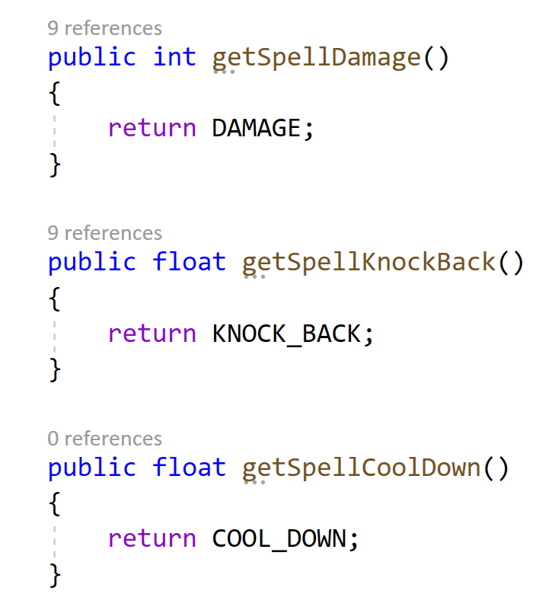
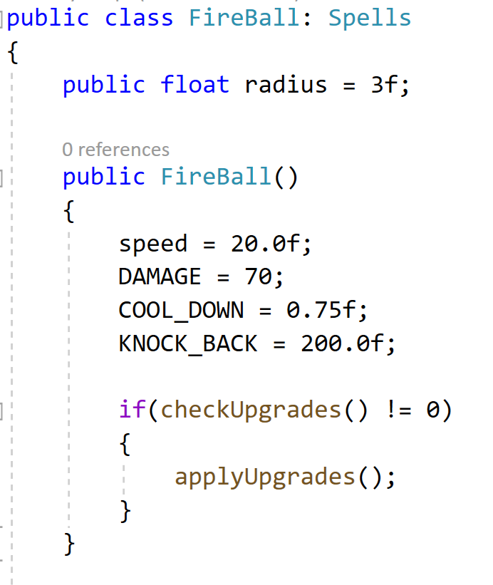
Example

Slide 22
7. Functional Cohesion
Def.
module performs exactly one action
Examples
get temperature of furnace
compute orbital of electron
calculate sales commission
Why is this good?
more reusable
corrective maintenance easier
fault isolation
reduced regression faults
easier to extend product

Slide 23
Coupling
Degree of interaction between two modules
Five levels of coupling
5. Data (best)
4. Stamp
3. Control
2. Common
1. Content (worst)

Slide 24
1. Content Coupling
Def.
one module directly references contents of the other
Example
module a modifies statements of module b
module a refers to local data of module b in terms of some numerical displacement within b
module a branches into local label of module b
Why is this bad?
almost any change to b requires changes to a

Slide 25
2. Common Coupling
Def.
two modules have write access to the same global data
Example
two modules have access to same database, and can both read and write same record
Why is this bad?
resulting code is unreadable
modules can have side-effects
must read entire module to understand
difficult to reuse
module exposed to more data than necessary

Slide 26
3. Control Coupling
Def.
one module passes an element of control to the other
Example
control-switch passed as an argument
Why is this bad?
modules are not independent
module b must know the internal structure of module a
affects reusability

Slide 27
4. Stamp Coupling
Def.
data structure is passed as parameter, but called module operates on only some of individual components
Example
calculate withholding (employee record)
Why is this bad?
affects understanding
not clear, without reading entire module, which fields of record are accessed or changed
unlikely to be reusable
other products have to use the same higher level data structures
passes more data than necessary
e.g., uncontrolled data access can lead to computer crime

Slide 28
5. Data Coupling
Def.
every argument is either a simple argument or a data structure in which all elements are used by the called module
Example
display time of arrival (flight number)
get job with highest priority (job queue)
Slippery slope between stamp & data (see queue)
Why is this good?
maintenance is easier
good design has high cohesion & weak coupling

Slide 29
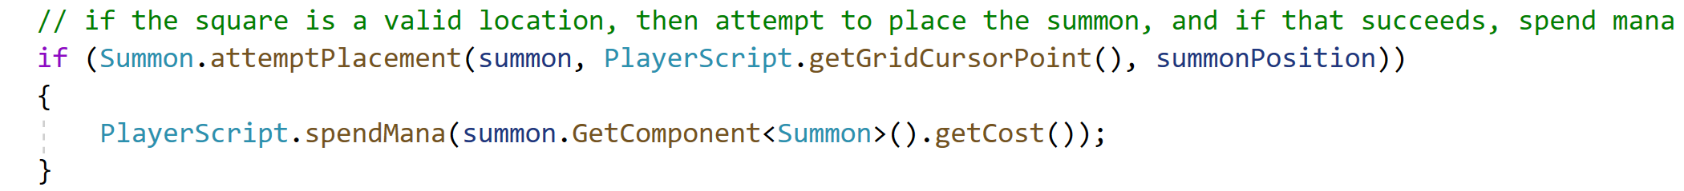
Example

Slide 30
Modules to Objects
Objects with high cohesion and low coupling
↑
Objects
↑
Information hiding
↑
Abstract data types
↑
Data encapsulation
↑
Modules with high cohesion and low coupling
↑
Modules

Slide 31
Information Hiding
Really “details hiding”
hiding implementation details, not information
Example
design modules so that items likely to change are hidden (private)
future change localized
change cannot affect other modules
data abstraction
designer thinks at level of ADT

Slide 32
Not necessarily “duh”.
For an object to send a message to another object…
… it must have visibility to it.

Slide 33
More about visibility
Implies that instances of ProductCatalog are visible from Register.
Definition:
Ability of one object to “see” or to “have reference” to another
As messages are between objects, they can only be sent from an object that has a reference to another
Visibility needs often emerge from interaction diagrams

Slide 34
Kinds of visibility
“Seeing” or “having reference” is usually a function of scope
That is, “Is object A within the scope of object B”
Four kinds:
Attribute visibility
Parameter visibility
Local visibility
Global visibility
So: for an object A to send a message to object B, B must be visible to A
But what kind of visibility do we choose?

Slide 35
1. Attribute Visibility
Relatively permanent form
That is, it exists as long as objects A and B exist
Declare a member variable (attribute) in the class.
Perhaps the most common form

Slide 36
2. Parameter Visibility
Exists when B is passed as a parameter to method of A
Compared to Attribute visibility, this is relatively temporary
That is, persists only within scope of called method
Can transform Parameter visibility to Attribute visibility

Slide 37
3. Local Visibility
Exists when B is declared as a local object within a method of A
Two ways to achieve this are by:
creating a new local instance and assigning it to a local variable
assigning the returning object from a method invocation to a local variable

Slide 38
4. Global Visibility
Exists when B is global to A
Relatively permanent visibility, but also the least common
At least two techniques to achieved this:
ordinary global variables
Singleton pattern

Slide 39
Summary
Good modules have strong cohesion and weak coupling
Data encapsulation, information hiding, & objects ease maintenance & reuse.
If you can’t see it, you can’t talk to it.

Slide 40
Designing Objects with Responsibilities
Using several specific design principles to guide OO design decisions.
Larman: “The critical design tool for software development is a mind well educated in design principles.”

Slide 41
Book Outline
Emphasis: There is no magic!
The book explores use of GRASP with two case studies
NextGen POS use cases
Startup
makeNewSale
enterItem
endSale
makePayment
Monopoly
Startup
playGame

Slide 42
Key Point
The assignment of responsibilities and design of collaborations are very important and creative steps during design, both while diagramming and while coding.

Slide 43
Mantra
Start assigning responsibilities by clearly stating the responsibilities.
If this seems like hard work, it is because it is hard work. It relies on having enough energy, and the willingness, to be an independent thinker.

Slide 44
Challenge
Old-school advice on OOD
“After identifying your requirements and creating a domain model, then add methods to the appropriate classes, and define the messages between the objects to fulfill the requirements.”
New-school advice: there are consequences to:
where we place methods
they way objects interact in our design
specific principles can help us make these decisions
Note: This is not UML! (Unified Modeling Language)
UML is a notation

Slide 45
Recall: The big picture
Object design is part of the larger modeling effort
Some inputs to modeling:
What’s been done?
How do things relate?
How much design modeling to do, and how?
What is the output?
Domain models, SDDs (Software Design Description )
Some outputs from modeling:
object design (UML diagrams – interaction, class, package)
UI sketches and prototypes
database models
sketches of reports and prototypes
Notes:
SDD = Software Design Description (IEEE 1016–2009), a standard that specifies the form of the document used to specify system

Slide 46
Design of objects
Responsibility-driven design (RDD)
What are an object’s responsibilities?
What are an object’s roles?
What are an object’s collaborations?
The term is important:
We are initially trained to think of objects in terms of data structures and algorithms (attributes and operations)
RDD shifts this by treating objects as having roles and responsibilities
Objects then become:
service providers
information holders
coordinators, controllers
interfaces, etc.

Slide 47
What is an object responsibility?
Doing
doing something itself (creating an object; performing a calculation)
initiating action in other objects
controlling and coordinating activities in other objects
Knowing
knowing about private encapsulated data
knowing about related objects
knowing about things it can derive or calculate
Responsibilities vary in “granularity”
big (hundreds of classes); example: “provide access to relational databases”
small (one method); example: “create an instance of Sale”
Notes:
1.Introduction
After identifying your requirements and creating a domain model, the method of object design is
carried out by adding methods to the software classes, and defining the messaging between the
objects to fulfill the requirements. There are deep principles and issues involved in these steps.
Deciding what methods belong where, and how the objects should interact, is important. And, this is
a critical step - this is at the heart of what it means to develop an object-oriented system, not drawing
domain model diagrams, package diagrams, and so forth.
It is possible to communicate the detailed principles and reasoning required to grasp basic object
design, and to learn to apply these in a methodical approach that removes the magic and vagueness.
The GRASP patterns are a learning aid to help one understand essential object design, and apply
design reasoning in a methodical, rational, explainable way. This approach to understanding and
using design principles is based on patterns of assigning responsibilities,
2.Responsibilities and Methods
A responsibility is defined as “a contract or obligation of a classifier.” Responsibilities are related to
the obligations of an object in terms of its behavior. Basically, these responsibilities are of the
following two types:
1. Knowing
2. Doing
Doing responsibilities of an object include:
· doing something itself, such as creating an object or
· doing a calculation
· initiating action in other objects
· controlling and coordinating activities in other objects
Knowing responsibilities of an object include:
· knowing about private encapsulated data knowing about related objects
· knowing about things it can derive or calculate
Responsibilities are assigned to classes of objects during object design. Relevant responsibilities
related to “knowing” are often inferable from the domain model, because of the attributes and
associations it illustrates. The translation of responsibilities into classes and methods is influenced by
the granularity of the responsibility. The responsibility to ‘provide access to relational databases”
may involve dozens of classes and hundreds of methods, packaged in a subsystem.
A responsibility is not the same thing as a method, but methods are implemented to fulfill
responsibilities. Responsibilities are implemented using methods that either act alone or collaborate
with other methods and objects.

Slide 48
What is an object collaboration?
Assumption:
responsibilities are implemented by means of methods
the larger the granularity of responsibility, the larger the number of methods
this may entail an object interacting with itself or with other objects
Therefore:
fulfilling responsibilities requires collaborations amongst different methods and objects

Slide 49
What is an object collaboration?
“Low representational gap”:
RDD is a metaphor
“Objects” are modeled as similar to persons / systems with responsibilities
“Community of collaborating responsible objects”
"Notice that although this design class diagram is not the same as the domain model, some class names and content are similar. In this way, OO designs and languages can support a lower representational gap between the software components and our mental models of a domain. That improves comprehension."
Applying UML and Patterns: An Introduction to Object-Oriented Analysis and Design and Iterative Development, Craig Larman (2004) (pg 11)
Notes:
Low Representational Gap
One of the reasons object oriented approaches are so valuable is that they allow the design of the software to closely match the real world. This makes it easier to understand what the code is doing, given an understanding of the problem domain. This doesn't mean that there should be no distance between the problem domain and the software design. Rather, we should try to keep the gap between the two small.
"Notice that although this design class diagram is not the same as the domain model, some class names and content are similar. In this way, OO designs and languages can support a lower representational gap between the software components and our mental models of a domain. That improves comprehension."
Applying UML and Patterns: An Introduction to Object-Oriented Analysis and Design and Iterative Development, Craig Larman (2004) (pg 11)

Slide 50
A couple of parenthetical comments
“Responsibility” here implies “non-interference”
This is idealized (i.e., in the real world this is not necessarily true in boundary cases)
However it is suitable enough for object design
Suitable for “programming-in-the-large”
As opposed to “programming-in-the-small”
This is a qualitative difference:
mass of details
amount of communication
this become overwhelming
“Practical” as opposed to “theoretical”

Slide 51
GRASP
Craig Larman’s methodical approach to OO design
GRASP stands for
General
Responsibility
Assignment
Software
Patterns

Slide 52
GRASP
In essence:
a tool to help apply responsibilities to OOD design
designed (and meant to be used as) methodical, rational, explainable techniques
They are “patterns of assigning responsibilities”
Note: the use of “pattern” here is slightly different from some that intended by the GoF (Gang of Four) book
Recognizes that “responsibility assignment” is something we already do:
UML interaction diagrams are about assigning responsibilities
Notes:
4.Patterns
Experienced object-oriented developers (and other software developers) buildup a repertoire of both
general principles and idiomatic solutions that guide them in the creation of software. These
principles and idioms, if codified in a structured format describing the problem and solution, and
given a name, may be called patterns.
[on board]
An example of a Pattern
Pattern Name : Information Expert
Solution: Assign a responsibility to the class that has the information needed to fulfill it.
Problem It Solves: What is a basic principle by which to assign responsibilities to objects?
In object technology, a pattern is a named description of a problem and solution that can be applied
to new contexts; ide ally, it provides advice in how to apply it in varying circumstances, and
considers the forces and trade-offs. Many patterns provide guidance for how responsibilities should
be assigned to objects, given a specific category of problem.
“One person’s pattern is another person’s primitive building block” is an object technology adage
illustrating the vagueness of what can be called a pattern. This treatment of patterns will bypass the
issue of what is appropriate to label a pattern, and focus on the pragmatic value of using the pattern
style as a vehicle for naming, presenting, learning, and remembering useful software engineering
principles.
GoF book (Gang of Four)
Design Patterns: Elements of Reusable Object-Oriented Software Author The "Gang of Four": Erich Gamma, Richard Helm, Ralph Johnson, John Vlissides

Slide 53
A bit more about “pattern” terminology
“Patterns” as applied to architecture:
invented by Christopher Alexander
context that of a “pattern language” for designing spaces used by humans
Classic design patterns for software
invented by the Gang of Four (GoF) (Gamma, Johnson, Helm, Vlissides)
“Patterns” is now a rather “loose” term
Conferences exist to look at patterns
"Pattern Language of Programs" http://hillside.net/plop/2007/
Larman has a special meaning for his GRASP patterns

Slide 54
What is a GRASP pattern?
A named and well-known problem/solution pair
General enough to be applied to new contexts
Specific enough to give advice on how to apply it
Especially important for novel situations
Also comes with a discussion of:
trade-offs
implementations
variations
Notes:
Characteristics of Good patterns
It solves a problem
It is a proven concept
The solution isn't obvious
It describes a relationship
The pattern has a significant human component
It solves a problem: Patterns capture solutions, not just abstract principles or strategies.
It is a proven concept: Patterns capture solutions with a track record, not theories or speculation.
The solution isn't obvious: Many problem-solving techniques (such as software design paradigms or methods) try to derive solutions from first principles. The best patterns generate a solution to a problem indirectly -- a necessary approach for the most difficult problems of design.
It describes a relationship: Patterns don't just describe modules, but describe deeper system structures and mechanisms.
The pattern has a significant human component: All software serves human comfort or quality of life; the best patterns explicitly appeal to aesthetics and utility.

Slide 55
Specifically GRASP
Defines nine basic OO principles
basic building blocks for OO designs
Meant to be “pragmatic”
Meant to be a “learning aid”:
aids naming the group of ideas
aids in presenting insight of ideas
aids in remembering basic, classic design ideas
Also intended for combination with:
a development process (UP)
an organizational metaphor (RDD)
a visual modeling notation (UML)

Slide 56
The Nine GRASP Patterns
Creator
Information Expert
Low Coupling
Controller
High Cohesion
Polymorphism
Pure Fabrication
Indirection
Protected Variations

Slide 57
Guideline
When coding, program at least some Start Up initialization first.
But during OO design modelling, consider the Start Up initialization design last, after you have discovered what really needs to be created and initialized.
Then design the initialization to support the needs of other use case realizations.

Slide 58
1. GRASP Creator
Problem: Who should be responsible for creating a new instance of some class?
Example: Who is responsible for creating “SalesLineItem”?
Object creation is one of the most common OO activities
“Creator” principle is meant to help us achieve:
low coupling
increased clarity
increased encapsulation
increased reusability
Notes:
The creation of objects is one of the most common activities in an object-oriented system.
Consequently, it is useful to have a general principle for the assignment of creation
responsibilities. Assigned well, the design can support low coupling, increased clarity,
encapsulation and reusability.
The basic intent of the
Creator pattern is to find a creator that needs to be connected to the created object in any event.
Creator Problem: Assign responsibility for creating a new instance of some class?
Solution: Determine which class should create instances of a class based on the relationship between potential creator classes and the class to be instantiated.
-----------------------------------------
Creator guides assigning responsibilities related to the creation of objects. The basic intent of the
Creator pattern is to find a creator that needs to be connected to the created object in any event.
The concept of aggregation is used in considering the Creator pattern. Aggregation involves things
that are in a strong Whole-Part or Assembly-Part relationship, such as Body aggregates Leg or
Paragraph aggregates Sentence. Aggregate aggregates Part, Container contains Contents, and
Recorder records Recorded are all very common relationships between classes in a class diagram.
The only guideline of the Creator is that the enclosing container or recorder class is a good candidate
for the responsibility of creating the thing contained or recorded.
Sometimes a creator is found by looking for the class that has the initializing data that will be passed
in during creation. This is actually an example of the Expert pattern. Initializing data is passed in
during creation via some kind of initialization method, such as a Java constructor that has
parameters.

Slide 59
Jargon reminder:
coupling: the degree to which each program module relies on other modules
cohesion: a measure of how well the operations in a module work together to provide a specific piece of functionality
encapsulation: synonym for “information hiding”
reusability: likelihood a segment of structured code can be used again to add new functionality with slight or no modification

Slide 60
1. GRASP Creator
Problem statement:
Who should be responsible for creating a new instance of some class?
Solution:
Assign class B the responsibility to create an instance of class A if one of these is true (& the more the better)…
B “contains” or compositely aggregates A.
B records A
B closely uses A.
B has initializing data for A (i.e., B is an Expert with respect to creating A).
Notes:
17. 17 Creator
who has responsibility to create an object?
By creator, assign class B responsibility of creating instance of class A if
B aggregates A objects
B contains A objects
B records instances of A objects
B closely uses A objects
B has the initializing data for creating A objects
where there is a choice, prefer
B aggregates or contains A objects
18. 18 Creator : Example Who is responsible for creating SalesLineItem objects?
Look for a class that aggregates or contains SalesLineItem objects.

Slide 61
1. GRASP Creator
Who is responsible for creating “SalesLineItem”?
Sale will contain many SalesLineItem objects
Creator GRASP pattern suggests Sale is one object that could fulfill this responsibility.
Consequences:
makeLineItem becomes a method in Sale.
we capture this decision in our UML design-model diagrams
Notes:
Who should be responsible for creating a SalesLineltem instance? By Creator, we should look for a
class that aggregates, contains, and so on, SalesLineltem instances. Since a Sale contains (in fact,
aggregates) many SalesLineltem objects, the Creator pattern suggests that Sale is a good candidate to
have the responsibility of creating SalesLineltem instances.
This leads to a design of object interactions as shown in the sequence diagram on the bottom.
This assignment of responsibilities requires that a makeLineltem method be defined in Sale. The
method section of a class diagram can then summarize the responsibility assignment results,
concretely realized as methods.

Slide 62
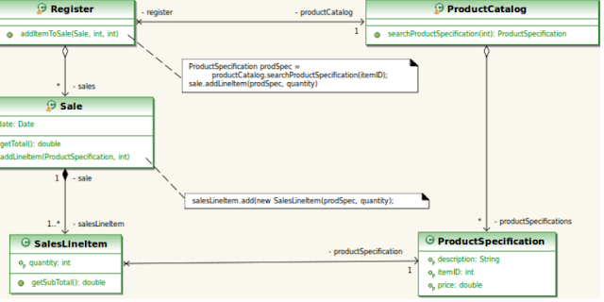
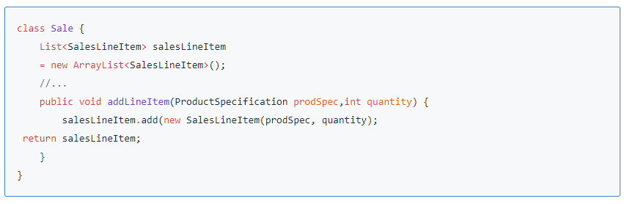
Another Look
https://www.sourcecodeexamples.net/2018/06/creator-grasp-pattern.html

Slide 63
GRASP patterns give you more…
Each of these patterns comes with:
a “discussion” section
a “contraindication” section
a “benefits” section
a “related patterns or principles” section
Important!
these patterns provide advice on assignment of responsibilities
patterns may conflict in their advice
therefor we must exercise some judgment in applying these patterns
the extra sections help us with this
This is not mechanical work!

Slide 64
1. GRASP Creator
Discussion:
intent is to support low coupling (i.e., creator is found that already needs to be connected to created object)
initializing data is sometimes an indicator of a good Creator
some object constructors have complex signatures
which objects have the information needed to supply parameter values for such constructors?
Contraindications
creation can be complex (recycled instances, creating an instance from a family of similar classes)
may wish to use Factory Method or Abstract Factory instead in these cases
Notes:
5.1.2.4.Contraindications
Often, creation requires significant complexity, such as using recycled instances for performance
reasons, conditionally creating an instance from one of a family of similar classes based upon some
external property value, and so forth. In these cases, it is advisable to delegate creation to a helper
class called a Factory rather than use the class suggested by Creator.

Slide 65
1. GRASP Creator
Benefits:
low coupling has already been mentioned
why is this good?
Related patterns or principles:
Low Coupling
Factory Method and Abstract Factory
Whole-Part pattern: defines aggregate objects that support encapsulation of components
Notes:
5.1.2.3.Benefits
Low coupling is supported, which implies lower maintenance dependencies and higher opportunities
for reuse. Coupling is probably not increased because the created class is likely already visible to the
creator class, due to the existing associations that motivated its choice as creator.

Slide 66
Guideline
Do the initialization design last.
Choose as an initial domain object a class at or near the root of the containment or aggregation hierarchy of domain objects.
This might be a facade controller or some other object considered to maintain all or most other objects.

Slide 67
2. GRASP Information Expert
Problem statement: What is a general principle of assigning responsibilities to objects?
Recall: design model may end up very large (hundreds of classes and methods)
If assignment of responsibilities is well chosen, result is system more easily understood than one with poorly chosen responsibility assignment.
Solution:
Assign a responsibility to the information expert
This expert is the class that has the information needed to fulfill the responsibility
Notes:
Information Expert is frequently used in the assignment of responsibilities; it is a basic guiding
principle used continuously in object design. Expert is not meant to be an obscure or fancy idea; it
expresses the common intuition that objects do things related to the information they have.
The fulfillment of a responsibility often requires information that is spread across different classes of
objects. This implies that there are many “partial” information experts who will collaborate in the
task. Whenever information is spread across different objects, they will need to interact via messages
to share the work.
Expert usually leads to designs where a software object does those operations that are normally done
to the inanimate real-world thing it represents. For example, in the real world, without the use of
electro-mechanical aids, a sale does not tell you it total; it is an inanimate thing. Someone calculates
the total of the sale. But in object-oriented software land, all software objects are “alive” or
“animated,” and they can take on responsibilities and do things. Fundamentally, they do things
related to the information they know.
The Information Expert pattern - like many things in object technology - has a real analogy. We
commonly give responsibility to individuals who have the information necessary to fulfill a task.
By Information Expert, we should look for that class of objects that has the information needed to
determine the total. We look both in the Domain Model and the Design Model to analyze the classes
that have the information needed. The Domain Model illustrates conceptual classes of the real-world
domain; the Design Model illustrates software classes.

Slide 68
Key idea:
(“Clear Statement” Rule): Start assigning responsibilities by clearly stating the responsibility.

Slide 69
2. GRASP Information Expert
If there are relevant classes in the design model, then look there first for classes…
NextGEN POS will end up with lots of functionality
One small part of this is a class that knows the grand total of a sale
“Clear Statement” rule could transform this into:
“Who should be responsible for knowing the grand total of a sale?”
Which class of objects has the information needed to determine the total?
… otherwise look into the Domain Model in order to use or expand its representations to suggest the creation of appropriate classes
Notes:
The problem here is knowing the grand total of a sale. According to the principles of Information
Expert
1. If there are relevant classes in the Design Model, look there first.
2. Else, look in the Domain Model, and attempt to use (or expand) its representations to inspire
the creation of corresponding design classes.

Slide 70
2. GRASP Information Expert
new method
new method
Notes:
It is necessary to know about all the SalesLineltem instances of a sale and the sum of their subtotals.
A Sale instance contains these; therefore, by the guideline of Information Expert, Sale is a suitable
class of object for this responsibility (total); it is an information expert for the work.
SalesLineItem.quantity and ProductSpecification .price are also needed to determine the line item
subtotal. The former know its quantity and its associated ProductSspecification ; therefore, by Expert,
SalesLineItem should determine the subtotal; it is the information expert.

Slide 71
2. GRASP Information Expert
new method
Notes:
Now, the solution can be represented by mean of the interaction design as shown here.

Slide 72
Comment
Notice how the initial assignment of responsibilities drove the design:
Result is the identification of several new methods
Interaction diagram helped us capture the result
Class model entities are also modified
Also notice the degree of delegation
“getSubtotal” (vs. “getPrice” and “getQuantity” to supply a multiplication operation)
Notes:
5.1.1.3.Benefits
Information encapsulation is maintained, since objects use their own information to fulfill tasks. This
usually supports low coupling, which leads to more robust and maintainable systems. Behavior is
distributed across the classes that have the required information, thus encouraging more cohesive
“lightweight” class definitions that are easier to understand and maintain. High cohesion is usually
supported.
5.1.1.4.Contraindications
There are situations where a solution suggested by Expert is undesirable, usually because of
problems in coupling and cohesion.

Slide 73
3. GRASP Low Coupling
Problem:
How can our design support
low dependency?
low change impact?
increased reuse?
Solution:
Assign a responsibility so that coupling remains low.
Use this principle to evaluate alternative assignment of responsibilities.
Notes:
Low Coupling is a principle to keep in mind during all design decisions; it is an underlying goal to
continually consider. It is an evaluative principle that a designer applies while evaluating all design
decisions.
In object-oriented languages such as C++. Java, and C common forms of coupling from TypeX to
TypeY include:
TypeX has an attribute (data member or instance variable) that refers to a TypeY instance, or Y itself
A TypeX object calls on services of a Type object.
TypeX has a method that references an instance of TypeY or TypeY itself, by any means.
These typically include a parameter or local variable of type TypeY, or the object returned
from a message being an instance of TypeY.
TypeX is a direct or indirect subclass of TypeY
TypeY is an interface, and TypeX implements that interface.
Low Coupling encourages assigning a responsibility so that its placement does not increase the
coupling to such a level that it leads to the negative results that high coupling can produce. Low
Coupling supports the design of classes that are more independent, which reduces the impact of
change. A subclass is strongly coupled to its superclass. The decision to derive from a superclass
needs to be carefully considered since it is such a strong form of coupling.
For example, suppose that objects need to be stored persistently in a relational or object database. In
this case it is a relatively common design to create an abstract superclass called PersistentObjeet
from which other classes derive. The disadvantage of this subclassing is that it highly couples
domain objects to a particular technical service and mixes different architectural concerns, whereas
the advantage is automatic inheritance of persistence behavior.
The extreme case of Low Coupling is when there is no coupling between classes. This is not
desirable because a central metaphor of object technology is a system of connected objects that
communicate via messages. If Low Coupling is taken to excess, it yields a poor design because it
leads to a few incohesive, bloated, and complex active objects that do all the work, with many very
passive zero-coupled objects that act as simple data repositories. Some moderate degree of coupling
between classes is normal and necessary to create an object-oriented system in which tasks are
fulfilled by a collaboration between connected objects.
Solution: Assign a responsibility so that coupling remains low.
Problem: How to support low dependency, low change impact, and increased reuse?
Coupling is a measure of how strongly one element is connected to, has knowledge of, or
relies on other elements. An element with low (or weak) coupling is not dependent on too
many other elements.. These elements include classes, subsystems, systems, and so on.
A class with high (or strong) coupling relies on many other classes. Such classes may be
undesirable; some suffer from the following problems:
Changes in related classes force local changes.
Harder to understand in isolation.
Harder to reuse because its use requires the additional presence of the classes on which it is dependent.

Slide 74
Key idea:
Coupling affects global understanding, but decisions about placing responsibility must be made more locally, usually by choosing from amongst alternatives.

Slide 75
Example
NextGen POS: dealing with Payments
“What object should be responsible for associating Payments with Sales?”
Three objects appear to be involved
Real-world domain: Register records a Payment (Creator?)
Also in real-world: A Register also records Sales.
Notes:
Consider the partial domain containing classes Payment, Register and Sale from the previous
example. Assume we have a need to create a Payment instance and associate it with the Sale. What
class should be responsible for this? Since a Register “records” a Payment in the real-world domain,
the Creator pattern suggests Register as a candidate for creating the Payment. The Register instance
could then send an addPayment message to the Sale, passing along the new Payment as a parameter.

Slide 76
Example
Suppose we apply our two previous GRASP patterns like so:
(Creator) Suggests Register as a candidate for creating Payments.
(Information Expert) Register knows about Payments, and therefore associates these with Sales
Resulting interaction diagram appears below
Notes:
A possible partial interaction diagram reflecting this is shown here.
This assignment of responsibilities couples the Register class to knowledge of the Payment class.

Slide 77
Example
Recall: Our GRASP pattern is to be applied to alternatives.
Another approach:
(Creator) Suggests Sales creates Payments
Notes:
An alternative solution to creating the Payment and associating it with the Sale is shown here.

Slide 78
Evaluating Alternatives
Which design choice results in lower coupling?
Notes:
In both cases we will assume the Sale must eventually be coupled to knowledge of a Payment,
Design 1, in which the Register creates the Payment, adds coupling of Register to Payment, while
Design 2, in which the Sale does the creation of a Payment, does not increase the coupling. Purely
from the point of view of coupling, Design 2 is preferable because overall lower coupling is
maintained. This an example where two patterns - Low Coupling and Creator - may suggest different
solutions.

Slide 79
Kinds of Coupling
Often applied to “types” or “classes”
Class X has an attribute referring to Class Y instance
Class X objects call on the services of a Class Y object
Class X has methods referencing instances of Class Y (i.e., parameters, local variables of Class Y)
Class X is a direct or indirect subclass of Class Y
Y is an interface, and Class X implements it
Note:
All of these are needed at some point
We are not trying to eliminate coupling, but rather make careful choices

Slide 80
Important contra-indicator
There is a least one set of objects and classes to which we must allow our code to be highly-coupled
Java libraries (i.e., javax.swing, java.util) etc.
C libraries
.NET libraries
Key features permitting this:
these are stable
they are widespread
Notes:
5.1.3.3.Contraindication
High coupling to stable elements and to pervasive elements is seldom a problem, For example, a Java
J2EE application can safely couple itself to the Java libraries (java.util, and so on), because they are
stable and widespread.
5.1.3.4.Benefits
not affected by changes in other components
simple to understand in isolation
convenient to reuse

Slide 81
4. GRASP Controller
Problem:
What first object beyond the UI layer receives and coordinates (“controls”) a system operation?
Solution:
Assign responsibility to a class based on one of the following:
class is “root object” for overall system (or major subsystem)
a new class based on use case name
Notes:
Systems receive external input events, typically involving a GUI operated by a person. Other
mediums of input include external messages such as in a call processing telecommunications switch,
or signals from sensors such as in process control systems.
In all cases, if an object design is used, some handler for these events must be chosen. The Controller
pattern provides guidance for generally accepted, suitable choices. The controller is a kind of facade
into the domain layer from the interface layer. Normally, a controller should delegate to other objects
the work that needs to be done; it coordinates or controls the activity. It does not do much work
The first category of controller is a facade controller representing the overall system, device, or a
subsystem. The idea is to choose some class na me that suggests a cover, or facade, over the other
layers of the application, and that provides the main point of service calls from the UI layer down to
other layers. It could be an abstraction of the overall physical unit, a class representing the entire
software system, a sub system or any other concept that the designer chooses to represent the overall
system.
If a use-case controller is chosen, then there is a different controller for each use case. Note that this
is not a domain object; it is an artificial construc t to support the system (a Pure Fabrication in terms
of the GRASP patterns). For example, if an application contains use cases such as Process Sale and
Handle Returns, then there maybe a ProcessSaleHandler class and so forth. The use case controller
is an alternative to consider when placing the responsibilities in a facade controller leads to designs
with low cohesion or high coupling, typically when the facade controller is becoming ‘bloated’ with
excessive responsibilities. A use-case controller is a good choice when there are many system events
across different processes; it factors their handling into manageable separate classes, and also
provides a basis for knowing and reasoning about the state of the current scenario in progress.
Solution: Assign the responsibility for receiving or handling a system event message to a class
representing one of the following choices:
Represents the overall system, device, or subsystem (facade controller).
Represents a use case scenario within which the system event occurs, often named <UseCaseName>Handler, <UseCaseName>Coordinator, or <UseCaseName>Session (use -case or session controller).
Use the same controller class for all system events in the same use case scenario.
Informally, a session is an instance of a conversation with an actor. Sessions can be of any length, but are often organized in terms of use cases (use case sessions).
Problem: Who should be responsible for handling an input system event?
An input system event is an event generated by an external actor. They are associated
with system operations - operations of the system in response to system events, just as
messages and methods are related.
For example, when a cashier using a POS terminal presses the “End Sale” button, he is
generating a system event indicating “the sale has ended.” Similarly, when a writer using
a word processor presses the “spell check” button, he is generating a system event
indicating “perform a spell check.”
A Controller is a non-user interface object responsible for receiving or handling a system
event. A Controller defines the method for the system operation.

Slide 82
Context
This usually is applied to the actions recorded in our SSDs (system sequence diagrams)
system events generated by some GUI
we do not write to the GUI just yet, but assume some UI layer
Therefore we do not have “window”, “view” or “document” classes
Be very careful here as we are so tied to GUIs when visualizing applications
GUI is meant to “delegate” tasks to system

Slide 83
Example (NextGen POS)
Which class of object should be responsible for receiving the enterItem() system event message?
ProcessSaleHandler? ProcessSaleSession? (these would be new)
These represent a receiver or handler of all system events of a use case scenario.
Register? POSSystem?
These represent overall “system”, “root object”, device, or subsystem.
Notes:
Consider an application, where several system operations are there e.g. enterItem(), maleNewSale,
makePayment(), endSale() etc. During analysis, system operations may he assigned to the class
System, to indicate they are system operations. However, this does not mean that a soft ware class
named System fulfills them during design. Rather, during design, a Controller class is assigned the
responsibility for system operations

Slide 84
Example NextGen POS
Here are the two basic alternatives.
(And how do we choose from amongst them?)
Notes:
Who should be the controller for system events such as enterItem and endSale ? By the Controller
pattern, here are some choices:
Register, POSSystem represent the overall system,” device, or subsystem
ProcessSaleHandler, ProcessSaleSession represent a receiver or handler of all system events of a use ease scenario
The choice of which of these classes is the most appropriate controller is influenced by other factors.
During design, the system operations identified during system behavior analysis are assigned to one
or more controller classes, such as Register

Slide 85
Caveats
A balance must be striken between having too many controllers and too few
More common problem: too few (i.e., “bloated controllers”)
Example:
single controller classes for all events (façade)
controller performs many of the events itself rather than delegate work
controller maintains a lot of state information about the system (e.g., variables and attributes)
Notes:
5.1.5.3.Benefits
Increased potential for reuse, and pluggable interfaces. It ensures that application logic is not
handled in the interface layer. The responsibilities of a controller could technically be handled in an
interface object, but the implication of such a design is that program code and logic related the
fulfillment of application logic would be embedded in interface or window objects. An interface-ascontroller
design reduces the opportunity to reuse logic in future applications, since it is bound to a
particular interface (for example, window-like objects) that is seldom applicable in other
applications. By contrast, delegating a system operation responsibility to a controller supports the
reuse of the logic in future applications. And since the application logic is not bound to the interface
layer, it can be replaced with a different interface.
Reason about the state of the use case. It is sometimes necessary to ensure that system operations
occur in a legal sequence. or to be able to reason about the current state of activity and operations
within the use case that is underway. For example, it maybe necessary to guarantee that the
makePayment operation can not occur until the endSale operation has occurred. If so, this state
information needs to be captured somewhere; the controller is one reasonable choice, especially if
the same controller is used throughout the use case (which is recommended).

Slide 86
5. GRASP High Cohesion
Problem:
How can we keep objects in our design
focused?
understandable?
manageable?
Solution:
Assign a responsibility so that cohesion remains high.
As with low coupling, use this evaluate alternatives to placing responsibilities in objects
Notes:
Like Low Coupling, High Cohesion is a principle to keep in mind during all design decisions; it is an
underlying goal to continually consider. It is an evaluative principle that a designer applies while
evaluating all design decisions.
Grady Booch describes high functional cohesion as existing when the elements of a component (such
as a class) “all work together to provide some well-bounded behavior.”
Here are some scenarios that illustrate varying degrees of functional cohesion:
1. Very low cohesion: A class is solely responsible for many things in very different functional
areas. Assume there exists a class called RDB-RPC-Interface, which is completely responsible
for interacting with relational databases and for handling remote procedure calls. These are two
vastly different functional areas, and each requires lots of supporting code. The responsibilities
should be split into a family of classes related to RDB access and a family related to RPC
support.
2. Low cohesion: A class has sole responsibility for complex task in one functional area. Assume
that there exists a class called RDBInterface, which is completely responsible for interacting with
relational databases. The methods of the class are all related, but there are lots of them, and a
tremendous amount of supporting code; there may be hundreds of thousands of methods. The
class should split into a family of lightweight classes sharing the work to provide RDB access.
3. High cohesion: A class has moderate responsibilities in one functional area and collaborates
with other classes to fulfill tasks. Assume that there exists a class called RDBInterface, which is
only partially responsible for interacting with relational databases. It interacts with a dozen other
classes related to RDB access in order to retrieve and save objects.
4. Moderate cohesion: A class has lightweight and sole responsibilities in a few different areas that
are logically related to the class concept, but not to each other. Assume that there exists a class
called Company, which is completely responsible for (a) knowing its employees and (b) knowing
its financial information. These two areas are not strongly related to each other, although both are
logically related to the concept of a company: In addition, the total number of public methods is
small, as is the amount of supporting code.
As a rule of thumb, a class with high cohesion has a relatively small number of methods, with highly
related functionality, and does not do too much work. It collaborates with other objects to share the
effort if the task is large.

Slide 87
Signs of Low Cohesion
Classes that do too many unrelated things or which do too much work
Such classes are:
hard to comprehend
hard to reuse
hard to maintain
delicate in that any change elsewhere in the system requires many changes in this class
In general:
the greater the granularity of classes, the lower the cohesion
but we do not want to go to the other extreme (i.e., lots and lots of classes, each doing one trivial thing)

Slide 88
Compare and contrast
(Yet again) What class should be responsible for creating and class instance and associating it with a Sale?
We have two options. Which shows both high cohesion and low coupling?
Notes:
The same example problem used for the Low Coupling pattern can be analyzed for High Cohesion,
Assume we have a need to create a (cash) Payment instance and associate it with the Sale. What
class should be responsible for this? Since Register records a Payment in the real-world domain, the
Creator pattern suggests Register as a candidate for creating the Payment. The Register instance
could then send an addPayment message to the Sale, passing along the new Payment as a parameter,
as shown in the figure shown on top.
This assignment of responsibilities places the responsibility for making a payment in the Register.
The Register is taking on part of the responsibility for fulfilling the makePayment system operation.
In this isolated example, this is acceptable; but if we continue to make the Register class responsible
for doing some or most of the work related to more and more system operations, it will become
increasingly burdened with tasks and become incohesive.
Imagine that there were fifty system operations, all received by Register. If it did the work related to
each, it would bec ome a “bloated” incohesive object. The point is not that this single Payment
creation task in itself makes the Register incohesive, but as part of a larger picture of overall
responsibility assignment, it may suggest a trend toward low cohesion.
And most important in terms of developing skills as an object designer, regardless of the final design
choice, the valuable thing is that at least a developer knows to consider the impact on cohesion.
Since the second design (shown graphically below) supports both high cohesion and low coupling, it
is desirable.

Slide 89
Contra-indicators
Simple people-management issues
Large class maintained by a single programmer
Performance
Distributed systems
Any place where the overhead of invoking an operation is a significant proportion of performing the operation
Notes:
5.1.4.3.Contraindications
There are a few cases in which accepting lower cohesion is justified.
One case is the grouping of responsibilities or code into one class or component to simplify
maintenance by one person (although be warned that such grouping may also make maintenance
worse). But for example, suppose an application contains embedded SQL statements that by other
good design principles should be distributed across ten classes, such as ten “database mapper”
classes. Now, it is common that only one or two SQL experts know how to best define and maintain
this SQL even if there are dozens of object-oriented programmers on the project. The software
architect may decide to group all the SQL statements into one class, RDBOperations, so that it is
easy for the SQL expert to work on the SQL in one location.
Another case for components with lower cohesion is with distributed server objects. Because of
overhead and performance implications associated with remote objects and remote communication, it
is sometimes desirable to create fewer and larger, less cohesive server objects that provide an
interface for many operations. This is also related to the pattern called Coarse-Grained Remote
Interface , in which the remote operations are made more coarse -grained in order to do or request
more work in remote operation call, because of the performance penalty of remote calls over a
network. As a simple example, instead of a remote object with three fine-grained operations
setName, setSalary and setHireDate , there is one remote operation setData , which receives a set of
data. This results in less remote calls, and better performance.
5.1.4.4.Benefits
Clarity and ease of comprehension of the design is increased.
Maintenance and enhancements are simplified.
Low coupling is often supported.
The fine grain of highly related functionality supports increased reuse because a cohesive class can be used for a very specific purpose.

Slide 90
Guideline
When there are alternative design choices, taking a closer look at the cohesion and coupling implications of alternatives.
You can also try to think ahead to future evolution pressures on the alternatives.
Choose an alternative with good cohesion, coupling, and stability in the presence of likely future changes.

Slide 91
Summary
High Cohesion and Low Coupling are the underlying theme of all patterns.
The Creator pattern supports low coupling by choosing a creator that already needs to be connected to created object.
Information Expert assigns responsibilities to the objects that have the information needed to complete the task.
Cohesion is maintained by delegating.
Sometimes patterns will give conflicting answers.
This is not an exact science, but be able to justify your choices.

Slide 92
Summary
No coupling is also undesirable
A central metaphor of object technology is a system of connected objects that communicate via messages.
Low Coupling is taken to excess leads to a few incohesive, bloated, and complex active objects that do all the work, with many very passive zero-coupled objects that act as simple data repositories.

Slide 93
Summary
Libraries are Highly Coupled. This is permitted because:
these are stable
they are widespread/proven
A subclass is by definition Highly coupled to its superclass.
Have a good reason for sub classing between modules/team members.
If you have a superclass for another team member, ensure that it takes on the properties of a library.
Well documented
Infrequent changes
You will be held to a higher standard!

Slide 94
Summary
Have a single controller that accepts messages (or brake it into several based on message type if it becomes too bloated.)
Your GUI is NOT your controller.
Do not tie your business logic with your user interface because this limits future changes.

Slide 95
Coding Standards, Developer Manual, and Using the Gantt

Slide 96


Slide 97


Slide 98


Slide 99
The Roast

Slide 100
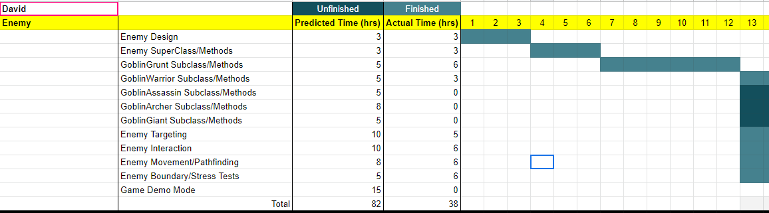
Roast of Bloonagins
Where are software patterns on your Gantt?

Slide 101
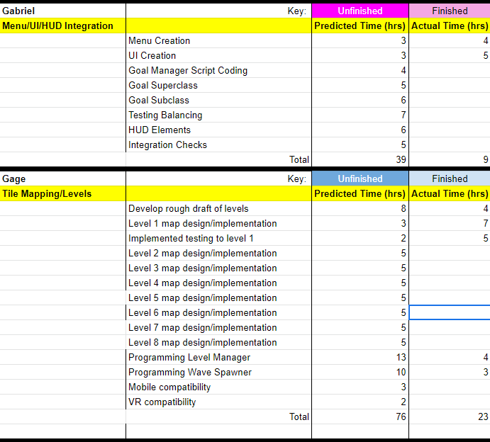
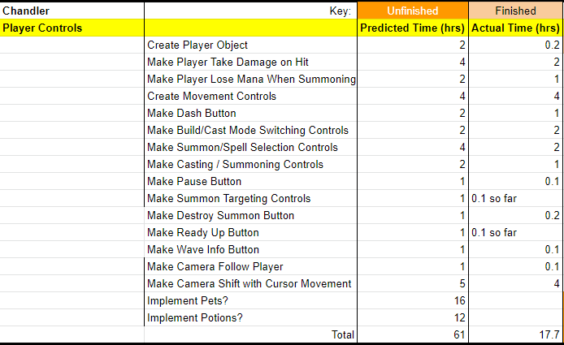
Roast of Bloonagins
Why are these individuals' hours low?

Slide 102
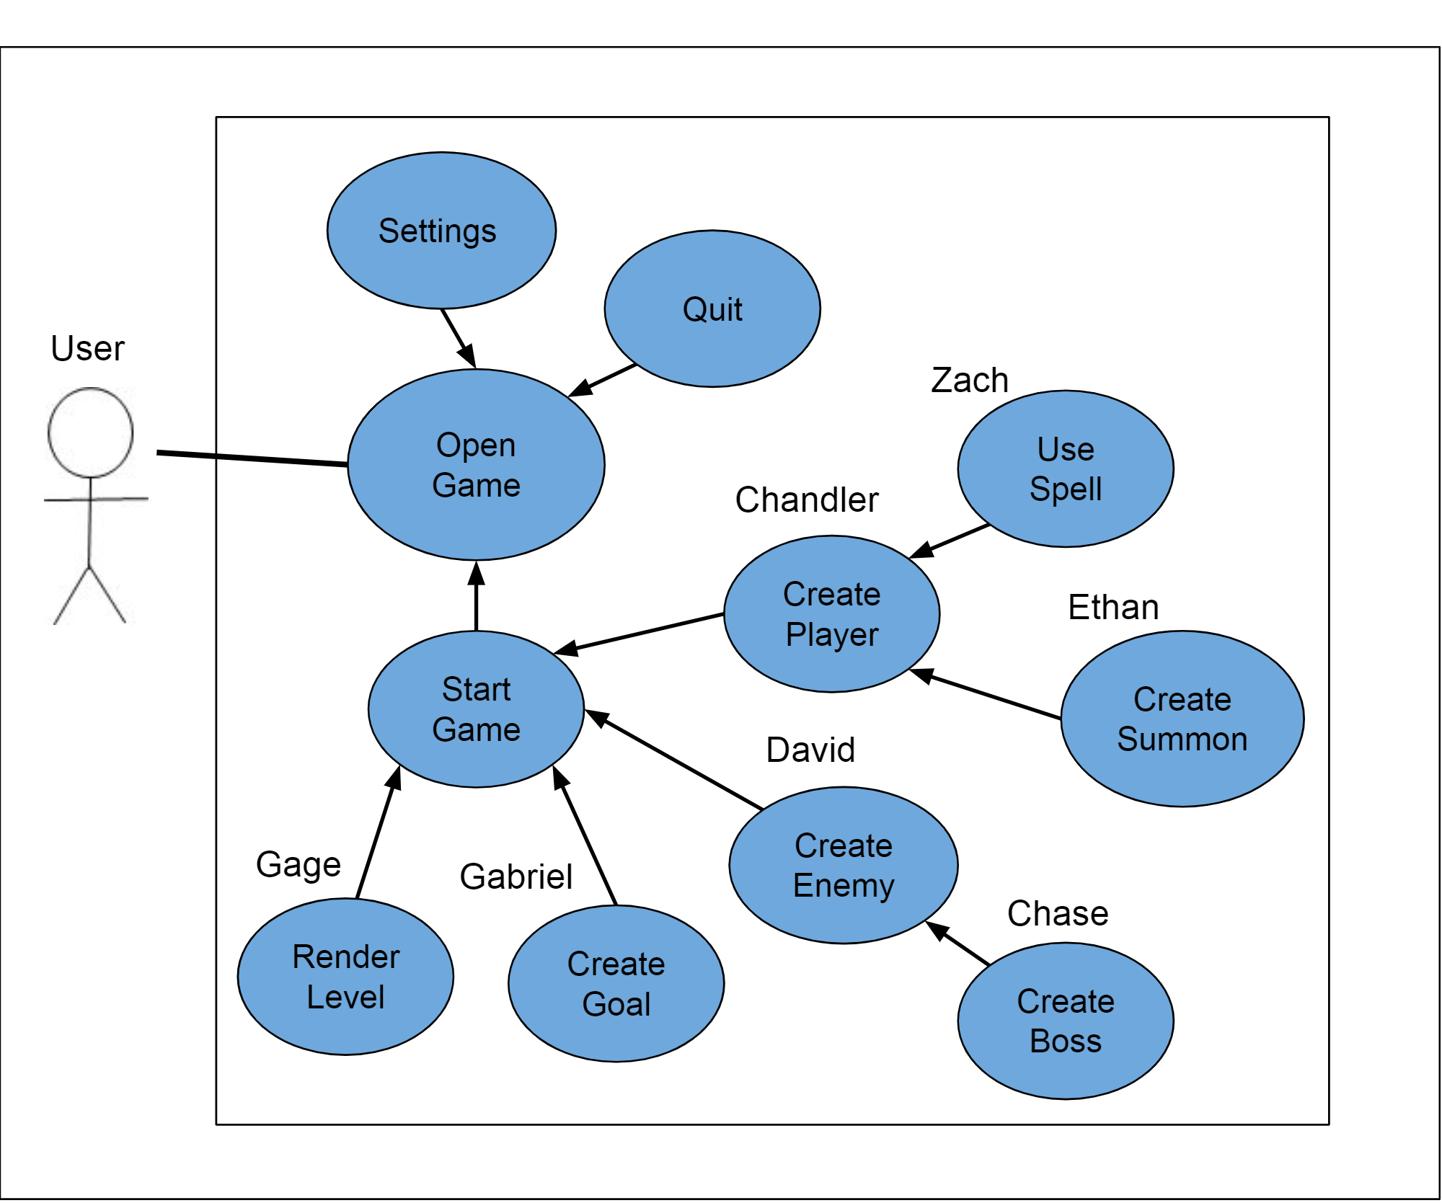
Roast of Bloonagins
One teammate owns the superclass of another's subclass
Is this level of coupling going to be a problem?
How are you going to manage it?

Slide 103
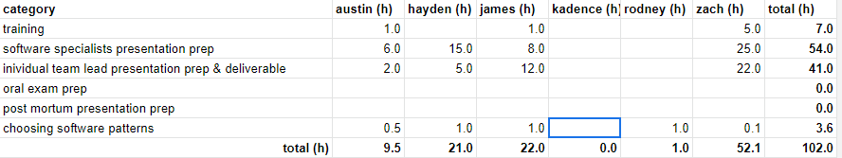
Roast of ScoSoft
Where is Kadence's pattern information?

Slide 104
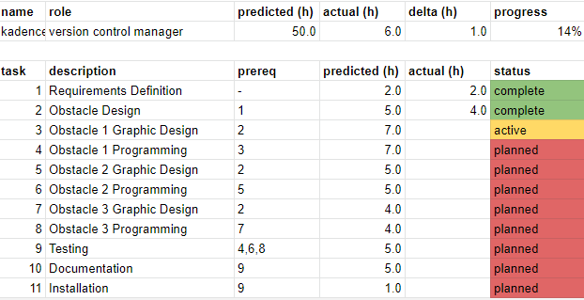
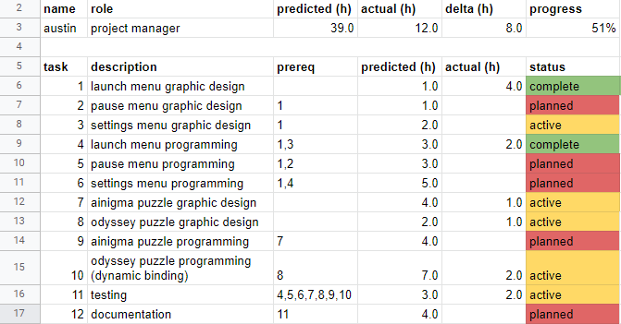
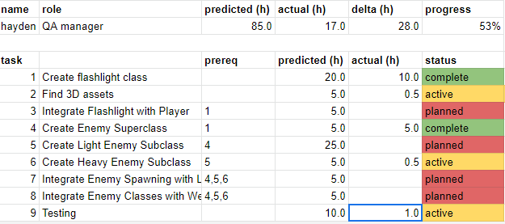
Roast of ScoSoft
Why are these individuals' hours so low?

Slide 105
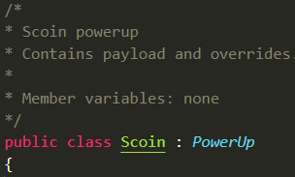
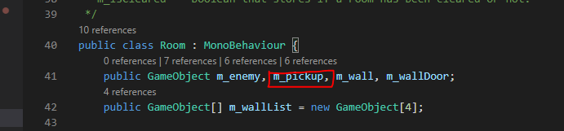
James' powerups are only created when Zach calls them.

Slide 106
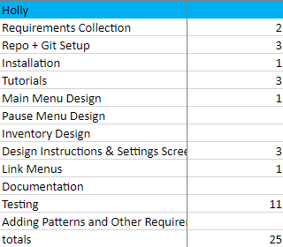
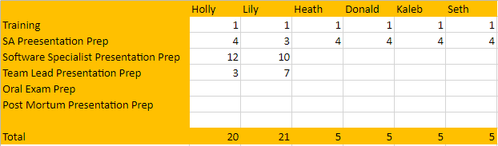
Roast of the Middle Men
Where are patterns and dynamic binding on Gantt?
Gantt Example
Overhead

Slide 107
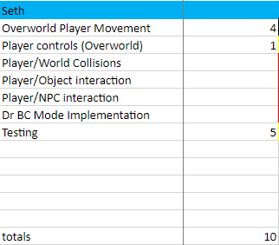
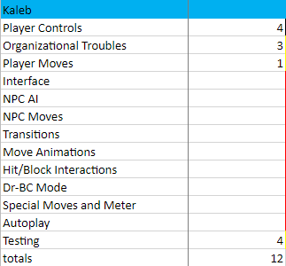
Roast of the Middle Men
Why are these individuals' hours low?

Slide 108
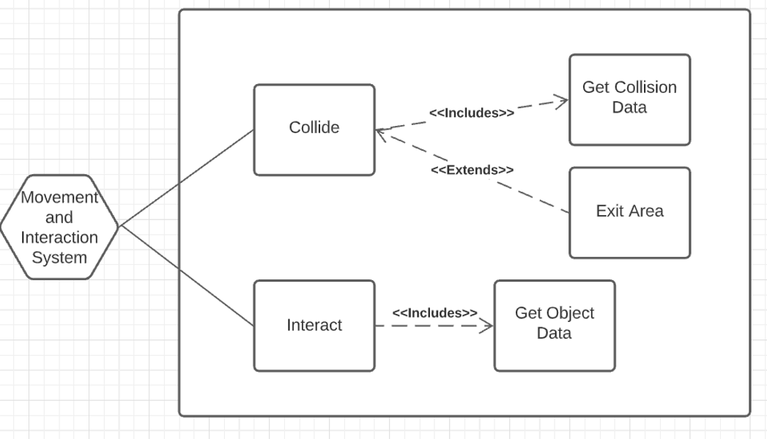
Roast of the Middle Men
Is there too much coupling between Seth and Donald's systems?

Slide 109
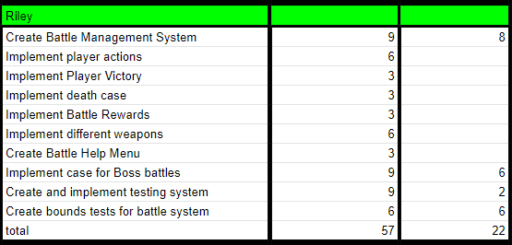
Roast of Team Cafés
Where are patterns/dynamic binding not in your Gantt?

Slide 110
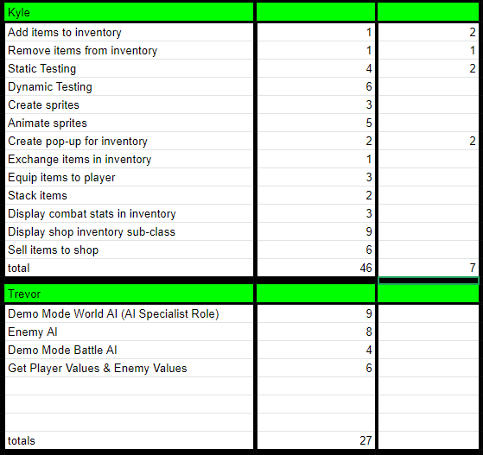
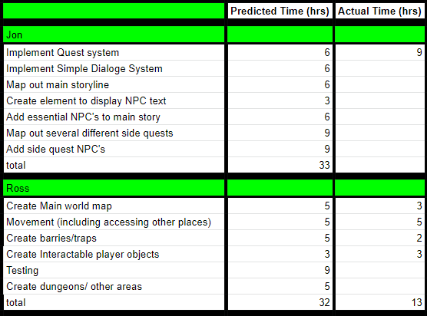
Roast of Team Cafés
Why are these individuals' hours so low?

Slide 111
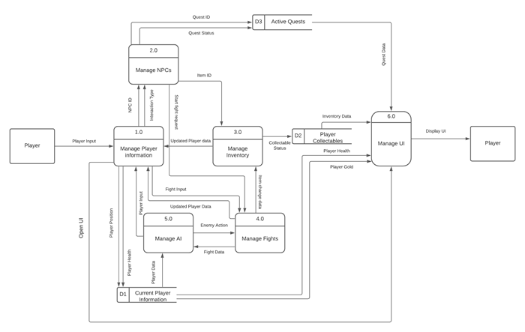
Roast of the Team Cafés
Isn't the Manage Player information going to create a high degree of coupling?

